Slide 1
Poetry Unit
The Romantic Period
Percy Bysshe Shelley’s “Ozymandias”

Slide 2
Romantic Period
1785-1832 (ranging)
Diverse range of years have been argued for what constitutes the beginning of the Romantic Period: ranging from the American’s declaration of independence from British rule in 1776 to the French Revolution in 1789
Follows the Age of Enlightenment/reaction to it
The shortest literary time period and one defined by the Victorian Period that followed it

Slide 3
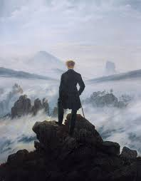

Slide 4

What Romanticists Loved:
Classical Antiquity (Greek/Roman history)
Shakespeare (revival of his popularity)
The Supernatural (the Gothic)
Glorification of the Ordinary
Spontaneity and the impulses of feelings
Nature
Fascination in national folk-lore
Themselves (i.e., individualism!)

Slide 5
Understanding Poetry
“Readers have a certain amount of “freedom” in navigating the poem. The caveat is that freedom often requires more work, more self-motivation, and a certain degree of confusion.”
“A poem helps the mind play with its well-trod patterns of thought, and can even help reroute those patterns by making us see the familiar anew.”
(By the way, April is National Poetry Month…)

Slide 6
How this “thing” (the poem) is made:
Looking up the term “poetry”: “a form of literary art which uses aesthetic and rhythmic qualities of language—such as phonoaesthetics, sound symbolism, etc.” If you are new to poetry, this definition might just create new confusions
“Poem” comes from the Greek poíēma, meaning a “thing made,” and a poet is defined in ancient terms as “a maker of things.” So if a poem is a thing made, what kind of thing is it?
Let’s consider the poem by breaking it down to the sum of its parts…

Slide 7
Basic Poetry Terms for Today
Line. Basic unit of a poem; measured in feet if metrical.
Stanza. Group of lines making up a single unit; like a paragraph in prose.
The speaker. The voice or "persona" of a poem. One should not assume that the poet is the speaker, because the poet may be writing from a perspective entirely different from his own, even with the voice of another gender, race or species, or even of a material object. The reader or listener must do more than just hear the voice of the poem to identify the speaker. It is important to examine the other elements of the poem, such as the situation, structure, descriptive details, figurative language and rhythms to help determine the speaker’s identity.

Slide 8
I met a traveller from an antique land,
Who said—“Two vast and trunkless legs of stone
Stand in the desert. . . . Near them, on the sand,
Half sunk a shattered visage lies, whose frown,
And wrinkled lip, and sneer of cold command,
Tell that its sculptor well those passions read
Which yet survive, stamped on these lifeless things,
The hand that mocked them, and the heart that fed;
And on the pedestal, these words appear:
My name is Ozymandias, King of Kings;
Look on my Works, ye Mighty, and despair!
Nothing beside remains. Round the decay
Of that colossal Wreck, boundless and bare
The lone and level sands stretch far away.”

Slide 9
Read the poem all the way through once without stopping to ask questions. Write down an immediate impression of the speaker in the poem: What kind of speaker do you imagine in your “mind’s eye”? Jot down anything that comes to mind. This is your first impression of the speaker.

Slide 10
How to annotate a poem
I met a traveller from an antique land,
Who said—“Two vast and trunkless legs of stone
Stand in the desert. . . . Near them, on the sand,
Half sunk a shattered visage lies, whose frown,
And wrinkled lip, and sneer of cold command,
Tell that its sculptor well those passions read
Which yet survive, stamped on these lifeless things,
The hand that mocked them, and the heart that fed;
And on the pedestal, these words appear:
My name is Ozymandias, King of Kings;
Look on my Works, ye Mighty, and despair!
Nothing beside remains. Round the decay
Of that colossal Wreck, boundless and bare
The lone and level sands stretch far away.”
Every line, every word of this poem needs to be read closely
Highlight words you need to look up in the dictionary; consider their definitions and connotations within the poem itself
Highlight anything else that interests you in terms of word choice and language: does anything rhyme (beyond the colored in words?)

Slide 11
Annotate the Poem Break it down and then put it back together again
I met a traveller from an antique land,
Who said—“Two vast and trunkless legs of stone
Stand in the desert. . . . Near them, on the sand,
Half sunk a shattered visage lies, whose frown,
And wrinkled lip, and sneer of cold command,
Tell that its sculptor well those passions read
Which yet survive, stamped on these lifeless things,
The hand that mocked them, and the heart that fed;
And on the pedestal, these words appear:
My name is Ozymandias, King of Kings;
Look on my Works, ye Mighty, and despair!
Nothing beside remains. Round the decay
Of that colossal Wreck, boundless and bare
The lone and level sands stretch far away.”

Slide 12
Reading the Poem
Listen….it’s essential to read a poem aloud if you want to fully understand it
A)Gielgud's reading
B) Price’s reading
C) Cranston’s reading

Slide 13
Who was your favorite reader?
Which reader of the poem conveyed the meaning in the most meaningful way to you?
A)Gielgud
B)Price
C)Cranston
Why? What did each reader make you think of the speaker(s) of the poem?

Slide 14
“Ozymandias” Poetry Competition
Horace Smith’s
Percy Shelley’s
In Egypt's sandy silence, all alone, Stands a gigantic Leg, which far off throws The only shadow that the Desert knows:— "I am great OZYMANDIAS," saith the stone, "The King of Kings; this mighty City shows "The wonders of my hand."— The City's gone,— Nought but the Leg remaining to disclose The site of this forgotten Babylon. We wonder,—and some Hunter may express Wonder like ours, when thro' the wilderness Where London stood, holding the Wolf in chace, He meets some fragment huge, and stops to guess What powerful but unrecorded race Once dwelt in that annihilated place.[
I met a traveller from an antique land Who said: Two vast and trunkless legs of stone Stand in the desert... near them, on the sand, Half sunk, a shattered visage lies, whose frown, And wrinkled lip, and sneer of cold command, Tell that its sculptor well those passions read Which yet survive, stamped on these lifeless things, The hand that mocked them and the heart that fed; And on the pedestal these words appear: 'My name is Ozymandias, king of kings; Look on my works, ye Mighty, and despair!' Nothing beside remains. Round the decay Of that colossal wreck, boundless and bare The lone and level sands stretch far away.

Slide 15
Percy Shelley’s “Ozymandias”
His most famous sonnet (14 lines, type of rhyme scheme)
Published January 11^{th,} 1818 (most likely written only 2 weeks earlier in the competition with his friend, Horace Smith)
Why do you think Shelley’s version has become more famous and more greatly appreciated in Western culture/literature than Horace Smith’s? What differences do you notice between the two versions?

Slide 16
Background on the Subject of the Sculpture
Diodorus Siculus, a Greek historian, is cited as giving the famous line to the sculpture—and ancient source, he was a Sicilian—contemporary of Julius Caesar
The historian translated the sculpture’s words to: “I am Ozymandias, king of kings: if any would know how great I am, and where I lie, let him exceed me in any of my works”
Percy Shelley was reading this Greek historian’s work
Shelley had a keen interest in the Classics (Greek and Roman) which was typical of other writers in the Romantic Period—Mary Shelley’s personal journal confirms that Percy Shelley was invested in reading in Greek the year of 1818
Ozymandias is the Greek translation of the actual Egyptian pharaoh’s name, Ramesses II…

Slide 17

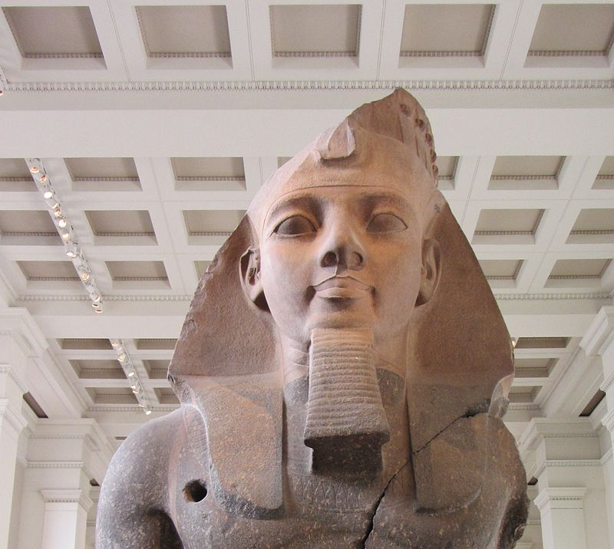

Ramesses II (the real “Ozymandias”)
Giovanni Belzoni extracted the colossal head in 1816 from the ruins of a temple at the West Bank of Thebes—brought to the British Museum in 1818.
But it’s been well established that Shelley could not have possibly seen the head in person before writing his poem (he was traveling in Italy with Mary Shelley by the time of the statue’s arrival to the British Museum)

Slide 18
Themes to Consider….
The Sublime
Hubris
The Romantic’s Fascination with Antiquity/the past

Slide 19
The Sublime
A lofty, ennobling seriousness as the main characteristic of certain poetry, as identified in the treatise On the Sublime, attributed to the 3rd-century Greek rhetorician Cassius Longinus. The concept took hold in the 18th century among English philosophers, critics, and poets who associated it with overwhelming sensation. In A Philosophical Inquiry into the Origin of our Ideas of the Sublime and the Beautiful (1757), Edmund Burke identified the sublime as the experience of the infinite, which is terrifying and thrilling because it threatens to overpower the perceived importance of human enterprise in the universe. Aesthetes and writers of the era saw the natural world and its wild, mysterious expanses as a gateway to the experience of the sublime. Romantic poets such as Percy Bysshe Shelley and William Wordsworth were influenced by this notion.
Poem suggests there is something vast and overpowering in nature that consumes civilization

Slide 20
Hubris
Excessive pride or self-confidence (hopefully reminds you of a certain “mad scientist”….)
Poem acts as a warning to the 19th-century British people

Slide 21
Next Time…
Check Blackboard for Poetry Schedule
More on the Romantics (Shelley, Keats, Wordsworth, Coleridge, and Lord Byron!)

